Slide 1

Homerun Team
Lan pham
Sadi Khatiwada
April Prospero Garcia

Slide 2
goal
To find out which are the top 10 team that has the highest possibility to make into the Playoff?
Find data: csv, API
Looking into data sources: clean, observes, manipulate data.

Slide 3
References
https://data.world/datasets/baseball
https://www.kaggle.com/open-source-sports/baseball-databank
https://rapidapi.com/theapiguy/api/free-nba

Slide 4
Data used:
CSV files
Batting
Pitching
Salaries

Slide 5
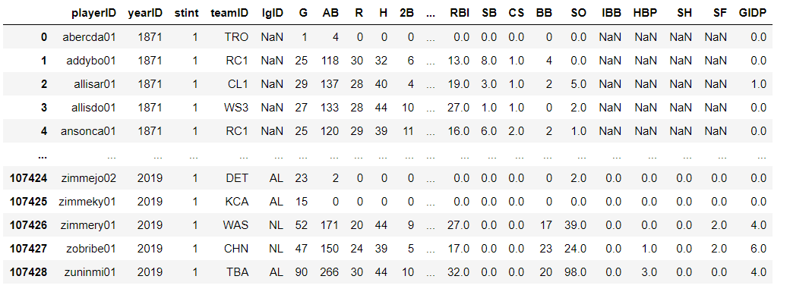
Batting data: 1871-2019

Slide 6
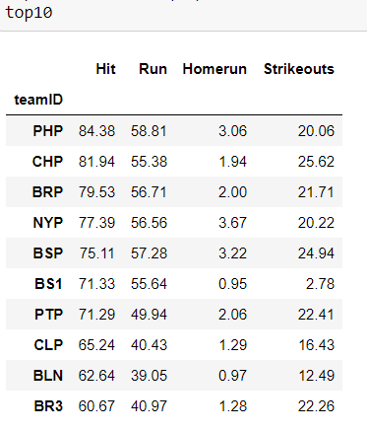
149 teams

Slide 7
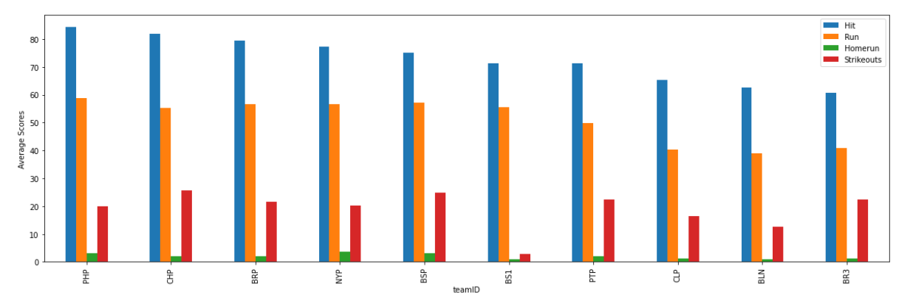

Slide 8
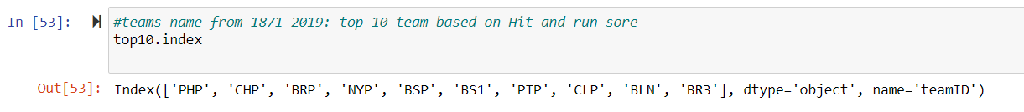
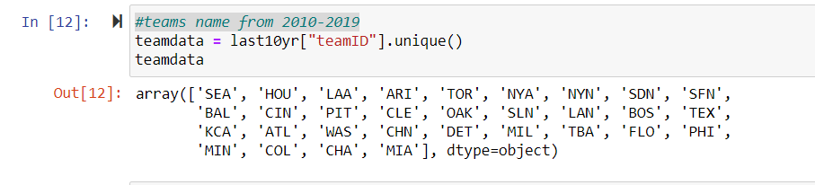
Teams (2010-2019) vs top 10 team (1871-2019)

Slide 9
